Slide 1
Internship
Presentation

Slide 2
Goals:
Image Classification
Pytorch
Git and GitHub
Model Deployment:
Flask
Docker
Object Detection:
Single Shot Detector
Faster R-CNN

Slide 3
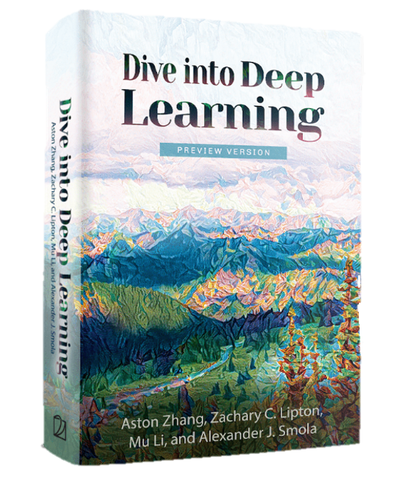
Week 1-3: Dive into Deep Learning
Topics:
Preliminaries:
Data Manipulation
Data Preprocessing
Linear Algebra and Calculus
Probability
Linear Neural Networks
Linear Regression
Softmax Regression
Multilayer Perceptrons
Layers
Activation functions
Model selection, underfitting and overfitting
Parameter Initialisation

Slide 4
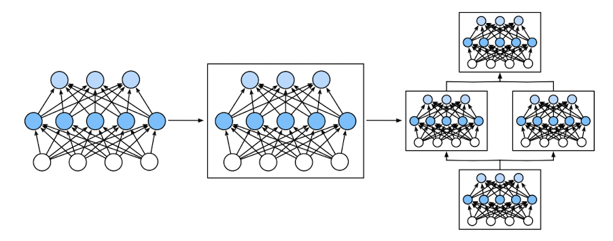
Week 1-3: Dive into Deep Learning
Deep Learning Computation
Layers and Blocks
Parameter Management
Saving and loading weights
Layer
Block
Multiple layers combines into Blocks

Slide 5
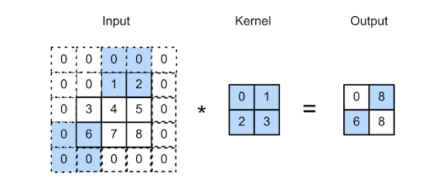
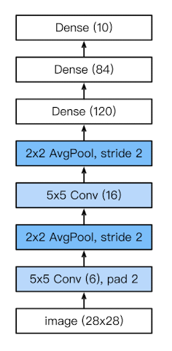
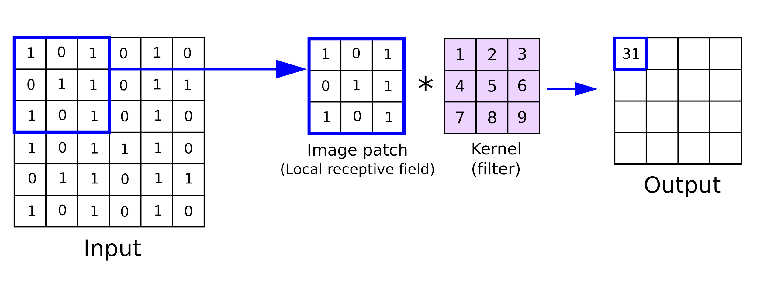
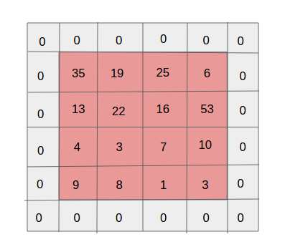
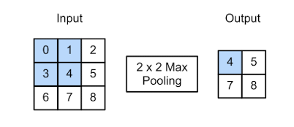
Week 1-3: Dive into Deep Learning
Convolutional Neural Networks
Convolutional Layers
Stride
Pooling
LeNet
Padding

Slide 6
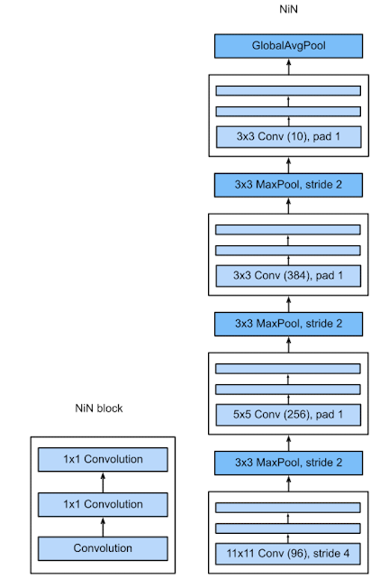
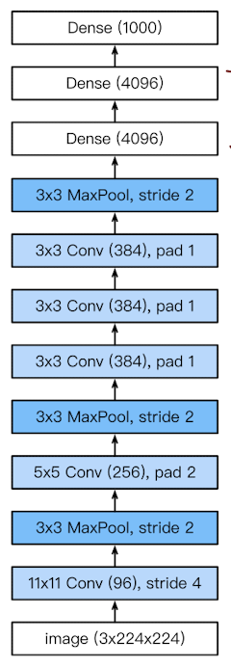
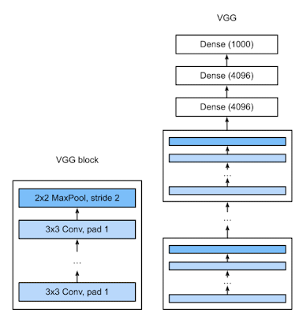
Week 1-3: Dive into Deep Learning
Modern convolutional Neural Networks
VGG
NiN
AlexNet

Slide 7
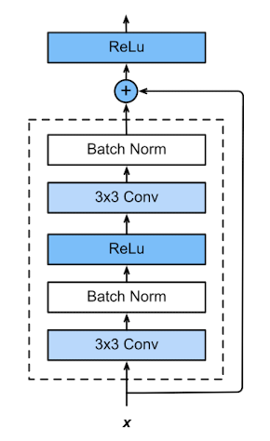
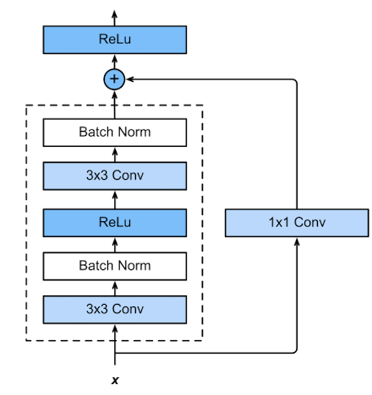
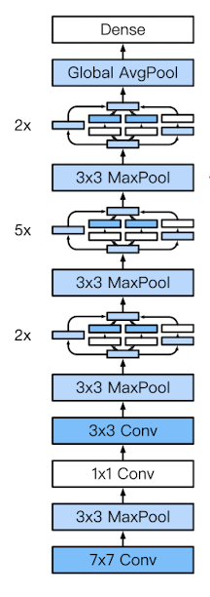
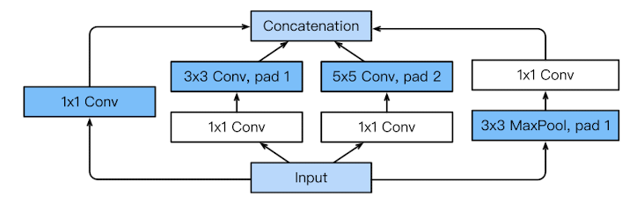
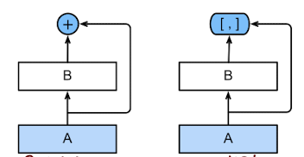
Week 1-3: Dive into Deep Learning
Modern convolutional Neural Networks
ResNet
DenseNet
GoogLeNet

Slide 8

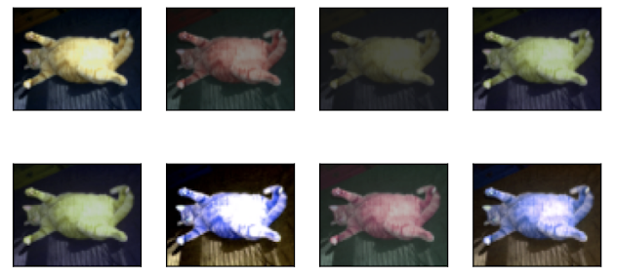
Week 1-3: Dive into Deep Learning
Computer Vision
Image Augmentation
Object Detection

Slide 9
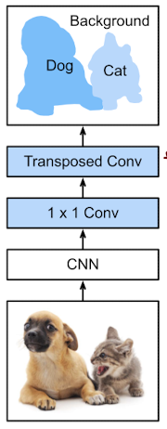
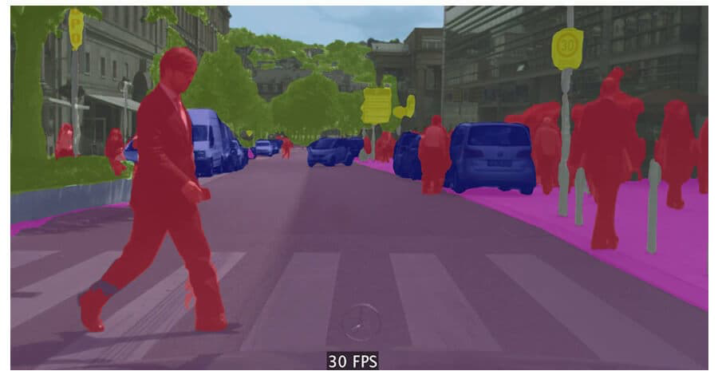
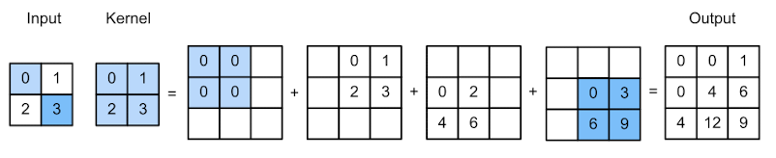
Week 1-3: Dive into Deep Learning
Computer Vision
Semantic segmentation
Transposed Convolutional Layer
Fully Convolutional Network

Slide 10
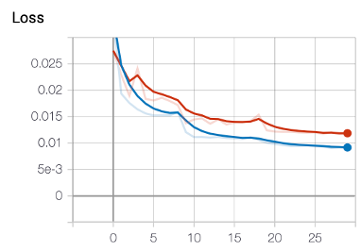
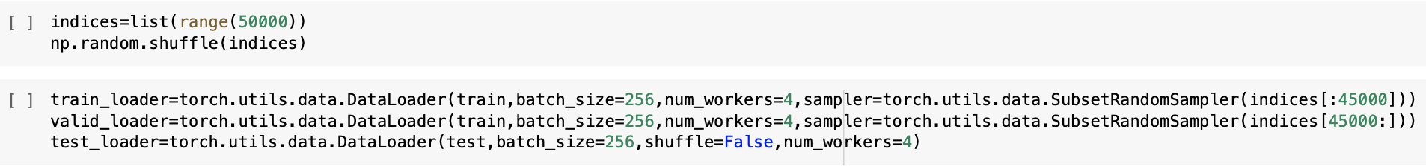
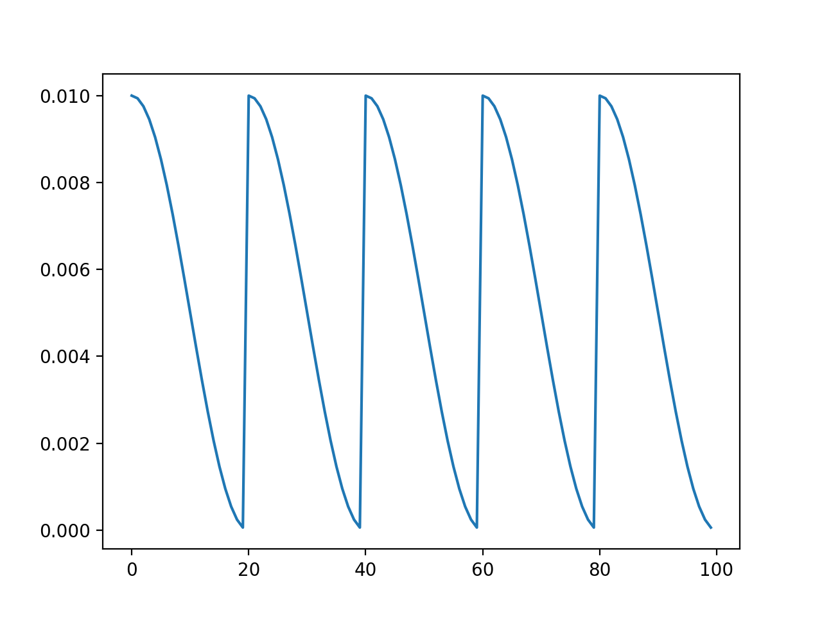
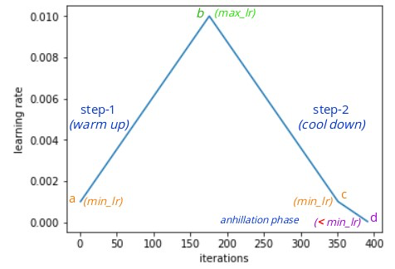
Week 3-4: Image classification
Cifar10 Dataset
Main takeaways:
Downloading the data from Kaggle straight into collab to save time and memory
CosineAnnealing
OneCycleLr
The effects of adjusting the hyperparameters on the accuracy
Git and GitHub

Slide 11
Week 3-4: Image classification
Achieved 0.822 accuracy on test set
Settings:
Batchsize: 256
Data Augmentations:
Resolution= 80x80
RandomHorizontalFlip
ColorJitter
RandomCrop
OneCycleLr scheduler with max learning rate=0.15, initial learning rate=0.0001
Weight decay=0.001
Epochs=50

Slide 12
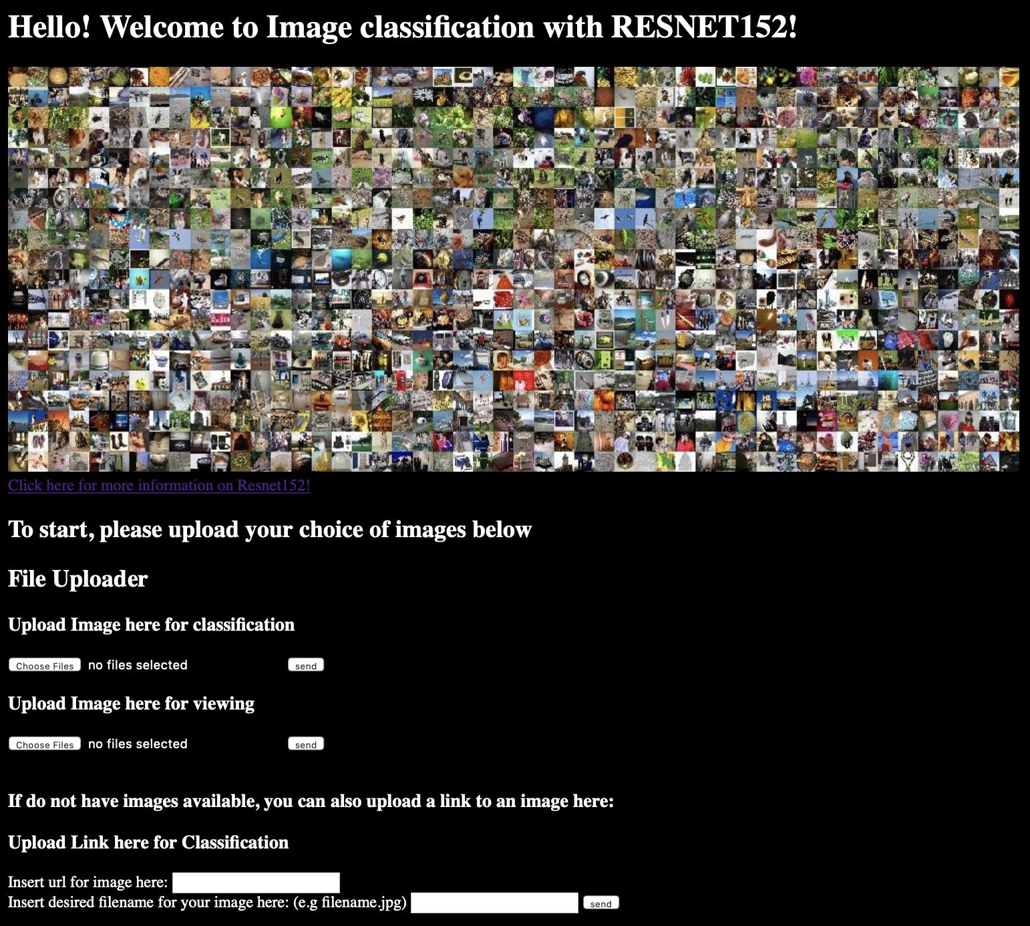
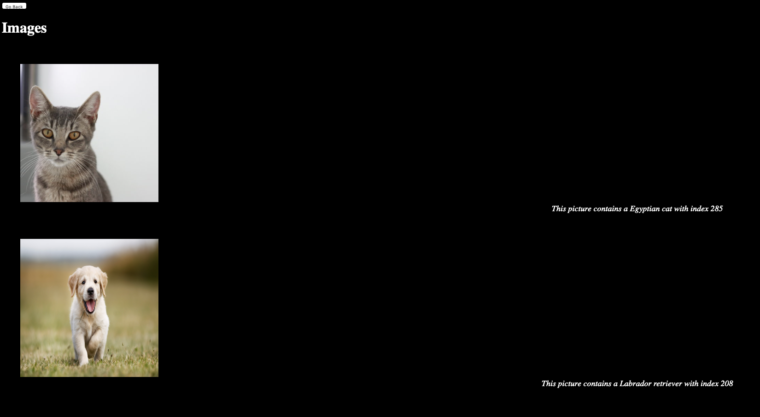
Week 4-5: Flask, FlaskRESTful, HTML, Docker

Slide 13
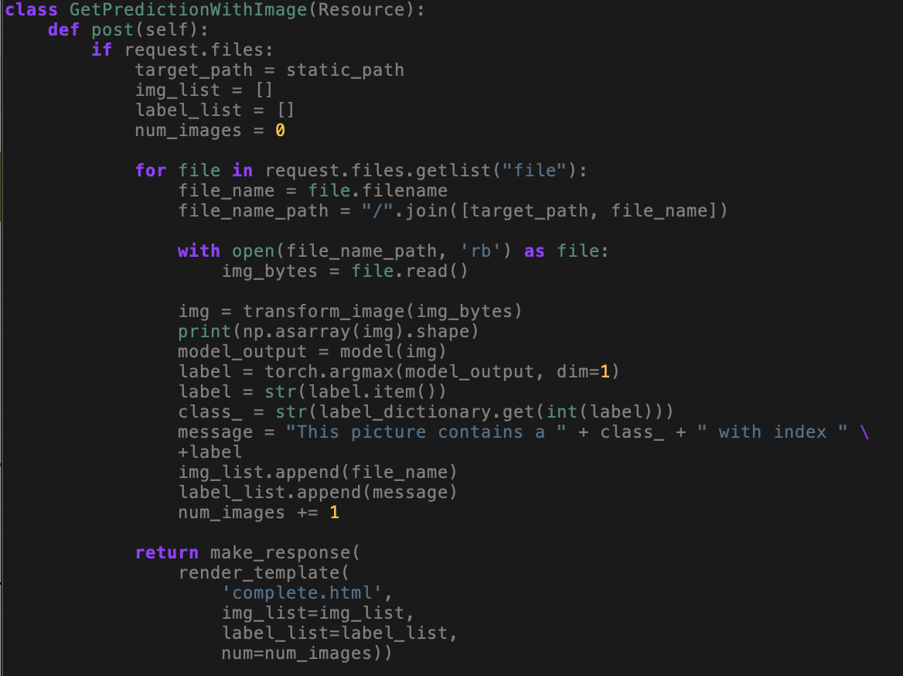
Week 4-5: Flask, FlaskRESTful, HTML, Docker

Slide 14
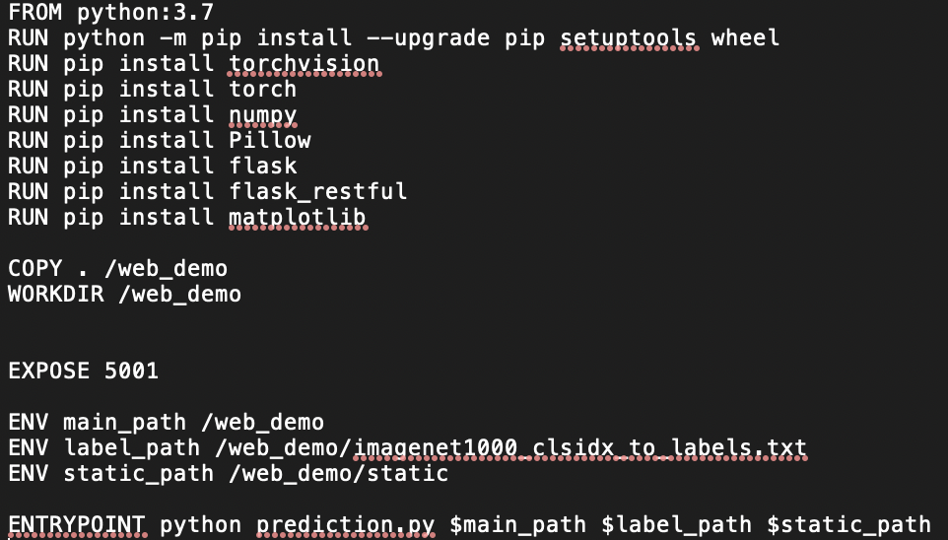
Week 4-5: Flask, FlaskRESTful, HTML, Docker

Slide 15
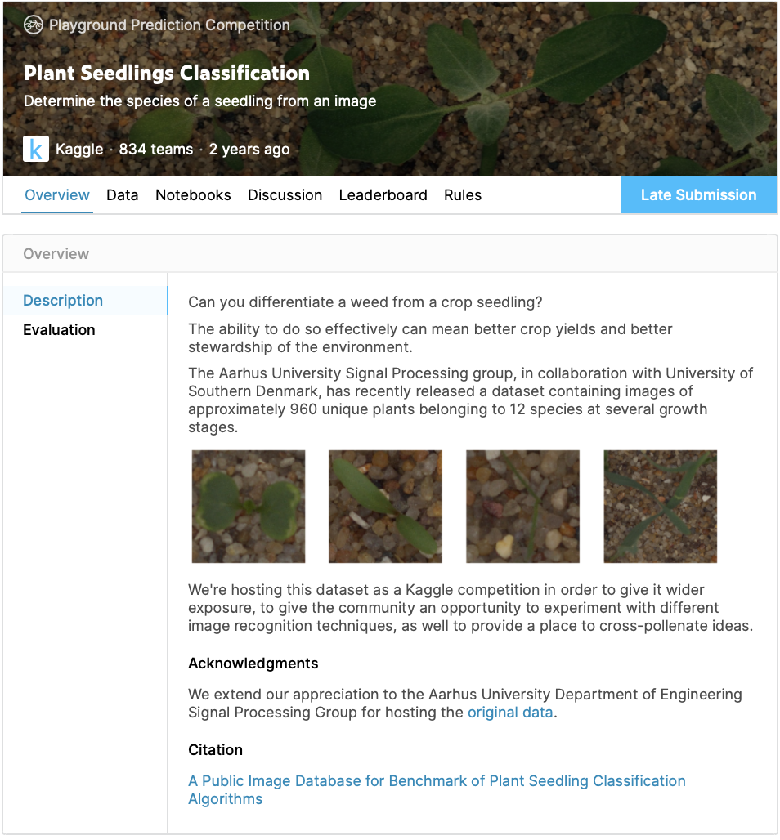
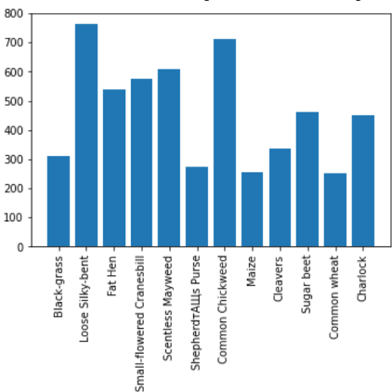
Week 5-6: Plants Seedling
Due to the lack of training data (5539 images), a pre-trained model(Resnet-50) on the ImageNet dataset is used.
Achieved a test average accuracy of 0.964 and an average precision of 0.962

Slide 16
Week 5-6: Plants Seedling
Main Takeaways:
How prepare dataset for input into the model using Dataset and DataLoader from torchvision
When the distribution of classes in the dataset is imbalanced, when splitting data into training, validation and test set, the distribution of classes should be roughly equal
There can be both grayscale and color images in the dataset.
To reduce training time, only weights towards the end will be trained, as layers towards the end has more specific features.
If dataset is very different from the dataset the model is trained on, additional layers can be trained.
Too much Data Augmentation can harm the accuracy
When the distribution of classes in the dataset is imbalanced, a weighted loss function can be used, where the weights will be the inverse of class proportions

Slide 17
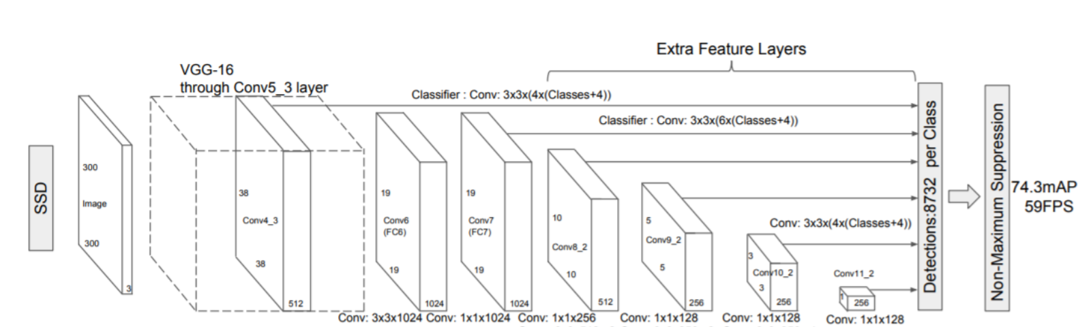
Week 7-8: Single Shot Detector Model Liu et al. 2016

Slide 18
Week 7-8: Single Shot Detector Model
Week 7-8: Single Shot Detector Model Liu et al. 2016
Main Takeaways:
How to prepare the data for input into the model
Data Augmentation for both image and bounding boxes
Effect of model settings on performance and speed
Data Augmentation
Number of default box shapes
Number of feature maps
Average precision for each classes using the predicted bounding boxes, where each predicted boxes are given a true positive and false positive with respect to the ground truths
SSD is fast, but it does not detect small objects well
Evident in the evaluation of PASCAL VOC07, where the average precision is 0.4918 for bottles and 0.5043 for potted plants which are generally smaller in images, as compared to the mAP of 0.7701.

Slide 19
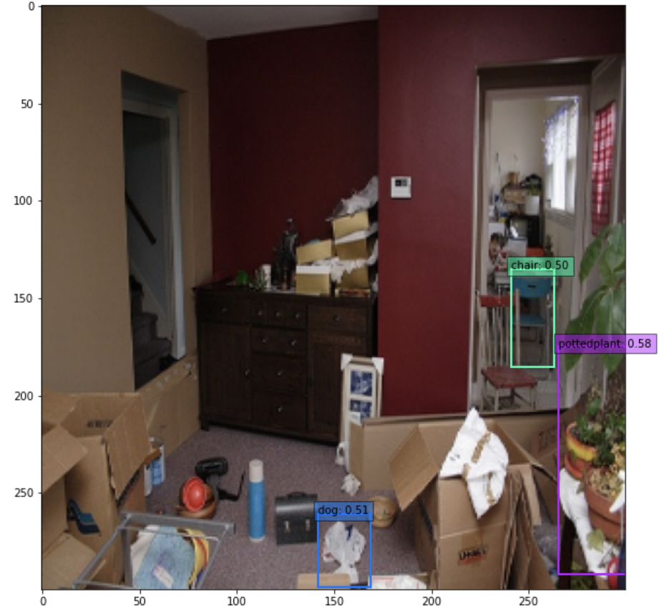
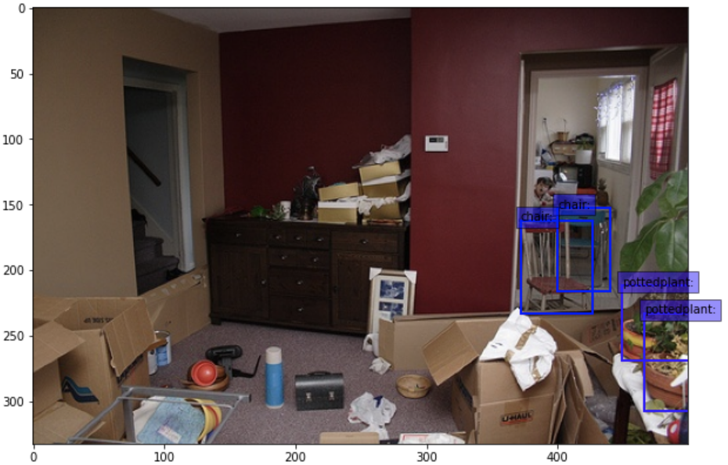
Actual
Predicted

Slide 20
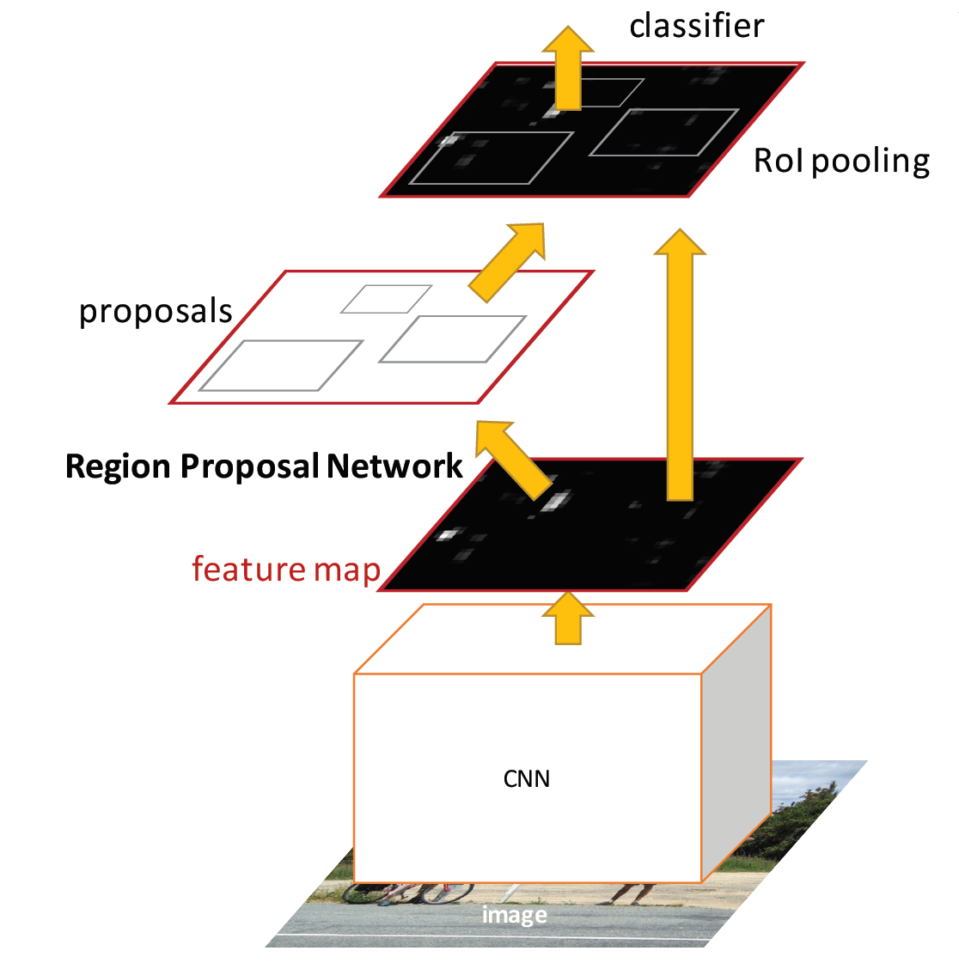
Week 9-10: Faster R-CNN Ren et al. 2015

Slide 21
Week 9-10: Faster R-CNN Ren et al. 2015
Used the pre-trained model on the COCO dataset from torchvision for evaluation on the PASCAL VOC 07 and 12 dataset
ResNet50 backbone with FPN
mAP of 0.37 on COCO dataset
Main takeaways:
The improvement in speed and accuracy, from 0.684 mAP 1-2 seconds/image in Fast R-CNN to 0.7730 mAP and 320ms/image in Faster R-CNN on PASCAL VOC2012 test set due to the introduction of Region Proposal Network.
During training mode, the model from torchvision takes in both the image and the ground-truth labels and outputs the loss, while in testing mode, it takes in the image and outputs the bounding box coordinates, class index and confidence scores.
When preparing the dataset, since both images and labels are input into the model during training, the labels needs to be of type dictionary, with keys: boxes, labels.

Slide 22
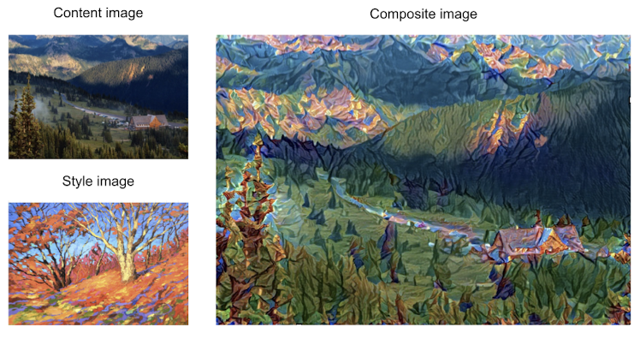
Conclusions
Challenges faced:
Docker
Object Detection
Topics of Interest:
Neural Style Transfer
Flask and HTML
Object Detection

Slide 23
References:
https://d2l.ai
https://anhreynolds.com/blogs/cnn.html
https://medium.com/@rishi30.mehta/object-detection-with-yolo-giving-eyes-to-ai-7a3076c6977e
https://theaisummer.com/Semantic_Segmentation/
https://towardsdatascience.com/introduction-to-convolutional-neural-networks-cnn-with-tensorflow-57e2f4837e18
https://www.kaggle.com/c/plant-seedlings-classification
https://github.com/amdegroot/ssd.pytorch
https://www.kaggle.com/pestipeti/pytorch-starter-fasterrcnn-train
https://arxiv.org/abs/1512.02325
https://arxiv.org/abs/1506.01497
https://towardsdatascience.com/ssd-single-shot-detector-for-object-detection-using-multibox-1818603644ca
https://machinelearningmastery.com/snapshot-ensemble-deep-learning-neural-network/
https://medium.com/dsnet/the-1-cycle-policy-an-experiment-that-vanished-the-struggle-in-training-neural-nets-184417de23b9

